Slide 1
Correlation, Regression & Nested Models
Rachael Bedford
Mplus: Longitudinal Analysis Workshop
26/09/2017

Slide 2
Overview
Victimization & Delinquency
Scatterplots
Correlation
Simple Linear Regression
Structural Equation Models
Nested Models
Testing Nested Models in Mplus

Slide 3
Victimization & Delinquency
Can victimization lead to delinquency?

Slide 4
Association
What is an association?
Step 1: scatterplot
Is there a relationship between the variables?
Positive/negative relationship?
Are there any outliers?
Linear relationship: increased victimization relates to higher levels of delinquency
Delinquency
Victimization
Notes:
What is an association: Go up in one up in the other – symetrical association
Cor is a standardised metric, which means that both variables have been transformed onto the same scale – r values show the strength of the correltion (low, medium, high) effect size

Slide 5
Correlation
Step 2: correlation
Correlation coefficient describes degree of relationship between two variables.
Standardised metric: both variables transformed to same scale.
R value: strength of the correlation
Effect sizes
Low ~0.3
Medium ~0.5
High ~0.8
Delinquency
Victimization
Notes:
What is an association: Go up in one up in the other – symetrical association
Cor is a standardised metric, which means that both variables have been transformed onto the same scale – r values show the strength of the correltion (low, medium, high) effect size

Slide 6
Regression
Does one variable (i.e. victimization) predict the other variable (i.e. delinquency).
Gives information about how a unit change in one variable will change the other.
Linear regression model: y = β0 + β1x + ε
y dependent variable
β0 intercept or constant: the value of y when x is 0
β1 gradient or slope: the increase in y when x increases by one unit
ε is the error
β0 + β1x is the equation for the predicted values of y which lie on a straight line and ε is the difference between the observed and predicted values of y

Slide 7
Ordinary Least Squares Regression
y = β0 + β1 x + ε
Error ε= y_{obs} – y_{model}
Delinquency (Y)
Assumptions
Residuals should have:
a normal distribution
zero mean (linear relationship)
constant variance
β1
1
β0
Victimization (X)
Notes:
Mean delinquency score when victimization is 0 (i.e. not victimized)

Slide 8
SEM: Reminder
 | Observed variable
 | Latent factor
 | Effects of one variable on another (e.g., regression)
 | Covariance or correlation
When the model only contains observed variables it is called path analysis.

Slide 9
Example 1: Victimization & Delinquency
Question: Does victimization at 13 years predict delinquency at 15 years?
Path diagram:
Victim 13
Del 15
Regression:
Y = Delinquency 15 yrs
X = Victimization 13 yrs

Slide 10
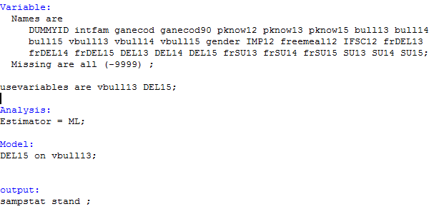
Example 1: Mplus input
Mplus code
Regression:
Y = Delinquency 15 yrs
X = Victimization 13 yrs
Analysis:
Estimator = ML;
Choose a model estimator:
Here ML (maximum likelihood)
OLS/MLR/others available
Output:
Sampstat stand;
Model:
Del15 on vbull13;
Standardised sample statistics
Regression

Slide 11
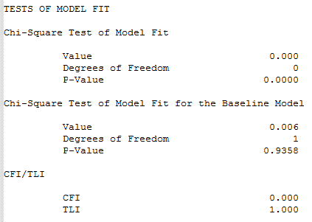
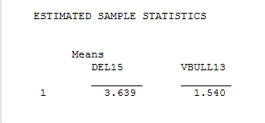
Example 1: Output (before results)
Fit statistics (here, model is saturated)
Do the means look reasonable?
GOOD!

Slide 12
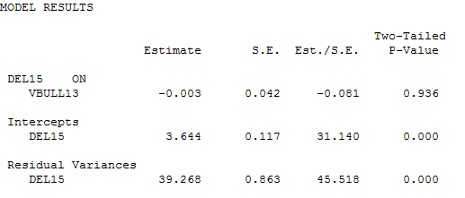
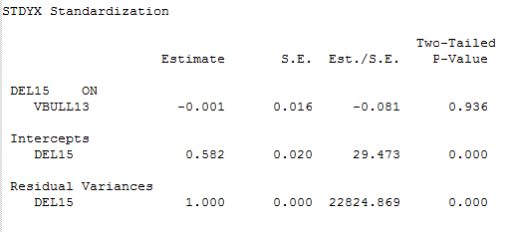
Example 1: Output (results)
Main model results:
Does victimization relate to later delinquency?
What are the values for: intercept
slope
residuals…?

Slide 13
Practical 1
Mplus code
Regression:
Y = Delinquency 15 yrs
X = Victimization 13 yrs
Analysis:
Estimator = ML;
Choose a model estimator:
Here ML (maximum likelihood)
OLS/ML/others available
Output:
Sampstat stand;
Model:
Del15 on vbull13;
Standardised sample statistics
Regression

Slide 14
Model Fit
Regression line has two parameters β0 + β1 (and error term)
From these we can estimate delinquency based on victimization score
A model is:
An approximation
A representation of the data
A way to summarise many data points
Important to assess how well our model ‘fits’ our data.
i.e. do the 2 parameters in our model effectively represent the data?
Notes:
Summarise many point of data

Slide 15
Model Fit
Look at the association
Choose an appropriate model
i.e. 2 parameters for simple linear relationship
Check whether model fits the data
Is there a relationship?
Does a linear model fit?
Need an extra parameter
Delinquency
Delinquency
Victimization
Victimization
Notes:
Summarise many point of data

Slide 16
Nested Models
Two models are nested if one model contains all the terms in the other + one additional term.
The larger model is the complete/full model
The smaller is the reduced/restricted model
By using model fit, nested models can be used to test whether a particular parameter is necessary.
Imagine a model with one parameter per observation: The model perfectly fits the data.
BUT would not be useful – doesn’t provide an approximation to extrapolate results.
So we try a model with fewer (k-1) parameters.
This reduced model will ALWAYS fit less perfectly but…
Is the full model a significantly better fit?
If no significant difference use reduced k-1 model
What about k-2 parameters, k-3, etc.
Until we reach k-x where fit is significantly worse.

Slide 17
Nested Models
Can also usually think about this in terms of pathways.
Full Model:
Victimization 12
Delinquency 15
Victimization 13
Reduced Model:
Victimization 12
Delinquency 15
Victimization 13
Notes:
An extra pathway in the model

Slide 18
Nested Models
The relationship between victimization and delinquency might differ in girls and boys – we can test this with nested models
Boys
Girls
Delinquency
Delinquency
Victimization
Victimization
Notes:
If adding parameter increase the likelihood that the model best describes the data (is increase significant)

Slide 19
Nested Models
1) Fit a model allowing boys and girls to be different
2) Fit a model constraining them to be the same (i.e. show the same relationship between victimization & delinquency)
Does the model with fewer parameters (which is…?) show significantly worse fit?
If not then (from a statistical point of view) we can constrain boys and girls to be the same.
Notes:
If adding parameter increase the likelihood that the model best describes the data (is increase significant)

Slide 20
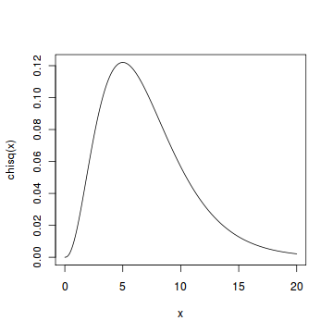
Nested Models: Comparing chi-sq
Chi-squared difference test sometimes called a likelihood ratio test
Test statistic follows a chi-squared distribution:
Chi sq reduced model – chi sq full model
DF = df reduced model – df full model
Degrees of Freedom (DF) relate to the number of free parameters in the model
Notes:
Likelihood ratio
Chi sq has diff dist depending on df
If adding parameter increase the likelihood that the model best describes the data (is increase significant)

Slide 21
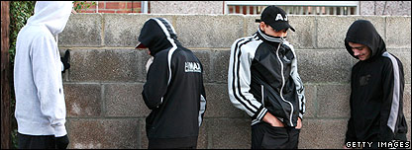
Example 2: Gender
Question: Is the effect of victimization on delinquency the same in boys and girls?
Females:
Multiple groups
Males:
Y = Delinquency 15 yrs
X = Victimization 13 yrs
Females:
Y = Delinquency 15 yrs
X = Victimization 13 yrs
Victim 13
Del 15
Males:
Victim 13
Del 15

Slide 22
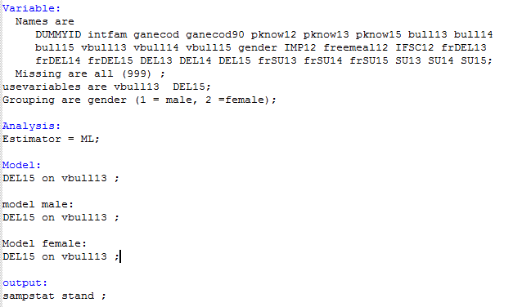
Example 2: Mplus input
Question: Is effect of victimization on delinquency the same in boys & girls?
Grouping are gender
(1 = male,
2 = female)
Model:
Del15 on vbull13;
Male:
Del15 on vbull13;
Female:
Del15 on vbull13;
Full model (M1)
Check chi sq model fit:
Saturated model (i.e. 0 dfs)

Slide 23
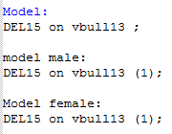
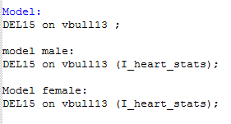
Example 2: Check fit statistics
Constrained model
Constrain relationship to be equal in males and females using syntax : (1)
You can put anything in the brackets as long as it’s the same for both groups…
Check Chi Squared fit statistics:

Slide 24
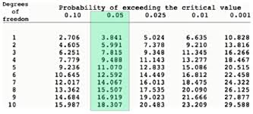
Example 2: Comparing model fit
Check Chi Squared fit statistics:
M2-M1
-
4.134 - 0 = 4.134
Check against chi square distribution
4.134 > 3.841
So…
Model 2 is a significantly worse fit than model 1.

Slide 25
Practical 2
Question: Is effect of victimization on delinquency the same in boys & girls?
Grouping are gender
(1 = male,
2 = female)
Model:
Del15 on vbull13;
Male:
Del15 on vbull13;
Female:
Del15 on vbull13;
Constrained model

