Slide 1
Getting Data into Mplus
Rachael Bedford
Mplus: Longitudinal Analysis Workshop
26/09/2017

Slide 2
How to get data into Mplus
Various options:
Stat transfer
Stat to Mplus command in stata
Syntax file in SPSS
First steps
Prepare the data
Define missing values
Notes:
e.g. measuring the same variable over time violates the assumption of independent observations

Slide 3
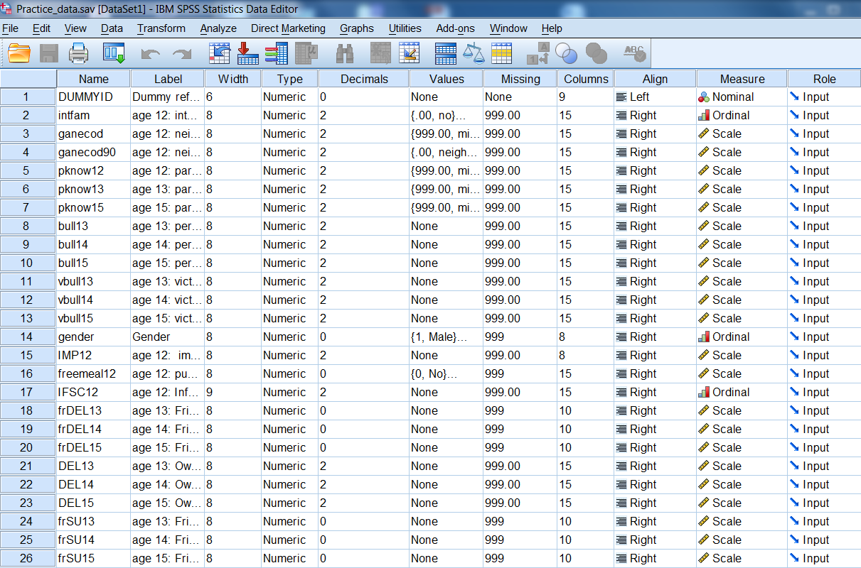
Data file SPSS
Notes:
e.g. measuring the same variable over time violates the assumption of independent observations

Slide 4
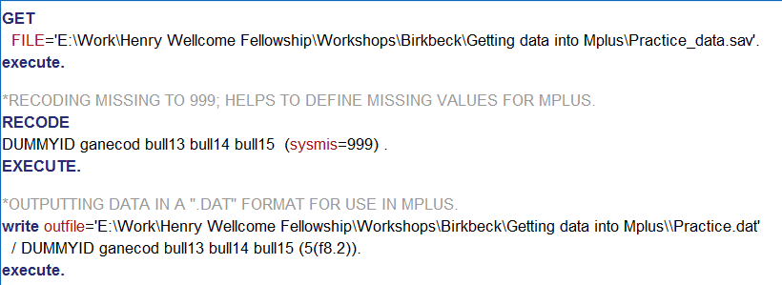
SPSS syntax
Calls data
Recodes missing from SPSS system missing to ‘999’
List variables
4 variables
8 characters
2 decimals
Outfile: Where and what format‘… ‘.dat’
Outputs SPSS data into a format that is compatible for
Mplus

Slide 5
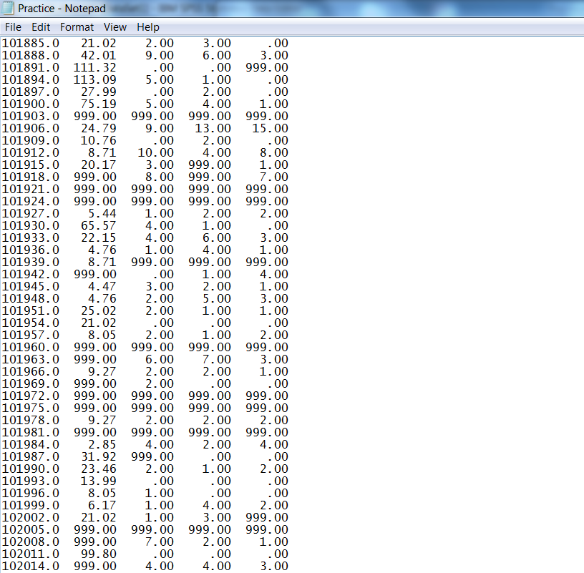
Dat file
NOTICE THAT THERE ARE NO VARIABLE NAMES !!

Slide 6
Important note
When using SPSS syntax to make a .dat file some versions insert a mysterious symbol in the first row.
It is also invisible in the dat format.
So… open your .dat file IN MPLUS and you will see this hidden symbol.
Delete it and save .dat file.
This isn’t an issue when you create a .dat file in any other way (i.e. with stata etc.)

Slide 7
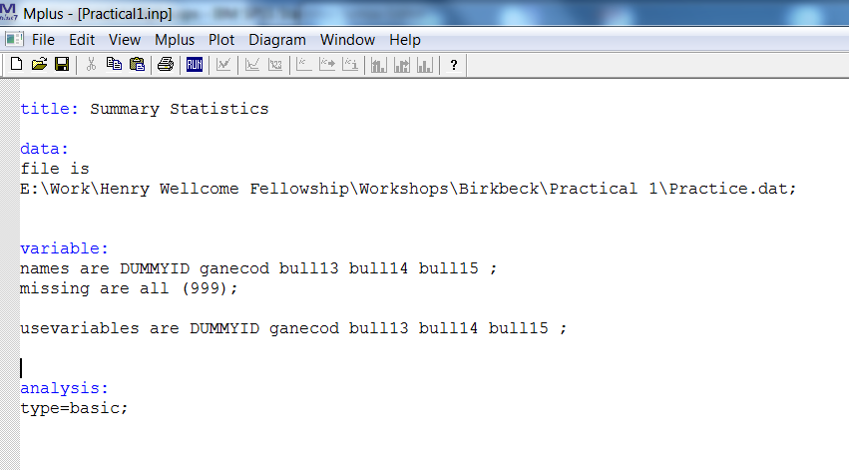
Create Mplus input file
(1) File name
(2) Name and order of variables from SPSS syntax
(3) ‘User’ defined missing (as per SPSS syntax)
(4) Variables to be used in the present analysis
(5) Type of analysis

Slide 8
Practical 1a
Get the data into Mplus using the syntax file.
Run syntax
(Open .dat file in mplus to check for symbol error)
Open a new mplus input file.
Add the following subsections:
title
data
variables (make sure these are in the correct order!!)
analysis
Run input file

Slide 9
Practical 1b
Run Mplus basic analysis and look at the output file:
1) What is the sample size?
Sample size = 4597
2) What is the mean bullying score at 13, 14 and 15 years?
13 years = 2.777
14 years = 2.412
15 years = 1.910
Notes:
2.777 2.412 1.910

