Slide 1
Autoregressive and Growth Curve Models
Rachael Bedford
Mplus: Longitudinal Analysis Workshop
26/09/2017

Slide 2
Overview
Examples using delinquency
Brief recap of SEM & autoregressive models
Growth Curve Models:
Linear
Quadratic
Summary

Slide 3
Delinquency Development
Delinquency 12 – 15 years
What might relate to changes in delinquency?
Being bullied: victimization
Substance use
Deprivation index (e.g. free school meals)

Slide 4
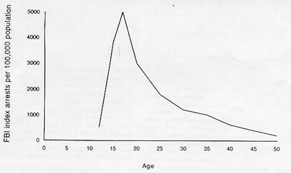
Age-Crime curve
This is the MEAN curve.
What about individual variability?
Notes:
Get rid of age crime curve
Parameters that describe the relationship

Slide 5
SEM notation
 | Observed variable
 | Latent factor
 | Effects of one variable on another (e.g., regression)
 | Covariance or correlation

Slide 6
Autoregressive Models
Analyse how the variance-covariance matrix of variables changes over time
First order autoregressive models for delinquency and victimisation at 12,13,14,15
Tell us if there is continuity over time.
DEL 12
DEL 13
DEL 14
DEL 15
VIC 12
VIC 13
VIC14
VIC 15
Notes:
Looks interrelationships. Not starts and change over time

Slide 7
Autoregressive Models
It is likely that delinquency and victimisation at each age are correlated.
And they may be related over time (cross-lag)
DEL 12
DEL 13
DEL 14
DEL 15
VIC 12
VIC 13
VIC14
VIC 15
DEL 12
DEL 13
DEL 14
DEL 15
VIC 12
VIC 13
VIC14
VIC 15
Notes:
Looks interrelationships. Not starts and change over time

Slide 8
Mini Practical
What is the code for this model in Mplus?
DEL 13
DEL 14
DEL 15
Model:
DEL14 on DEL13;
DEL15 on DEL14;
VIC14 on VIC13;
VIC15 on VIC14;
DEL13 with VIC13;
DEL14 with VIC14;
DEL15 with VIC15;
VIC 13
VIC 14
VIC15

Slide 9
Key Model Commands
Mplus Code:
EL2 on EL1;
EL3 on EL2;
EL4 on EL3;
EL1-EL4 on group;
[ ] – mean
[X1]
- variance
X1
with – correlation or covariance
X1 with X2
by – factor is indicated by
F1 by X1 X2 X3
on – regression
Y1 on X1
; - end of a command
Y1 on X1;
e
e
e
e
EL1
ß
EL2
EL3
EL4
Group

Slide 10
Growth Curve Models (GCMs)
Like autoregressive models, GCMs explain change in the variance-covariance matrix over time.
But, GCMs enable inter- and intra-individual change to be quantified.
3 time points-linear growth
3+ time points-can fit curvilinear functions

Slide 11
Intercept & slope latent factors
Expressive language
6 12 24 36
Age in months

Slide 12
Intercept & slope latent factors
Expressive language
6 12 24 36
Age in months

Slide 13
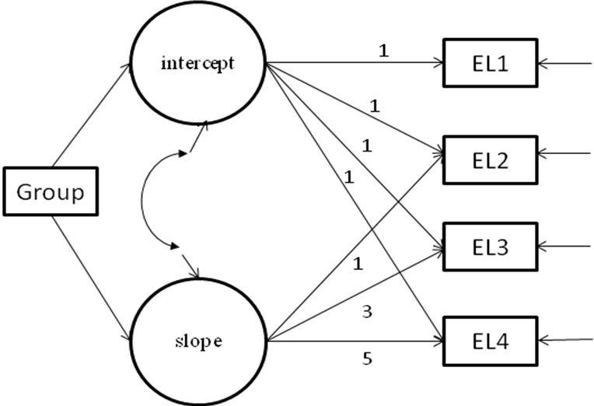
Basic GCM explained
Regression coefficients of language on intercept fixed at 1
Regression of intercept and slope on group.
Mean of slope freely estimated.
Regression coefficients of language on slope fixed at age/difference between visits.
Notes:
equal to one another, to reflect that fact that the same variable is measured at each time point: no growth between EL1 and EL4.

Slide 14
Adding a quadratic term
intercept
Del 12
Del 13
slope
Covariate
0
Del 14
1
quadratic
4
Del 15
9

Slide 15
Equations! (Thank you Muthéns)
i
13
14
s
15

Slide 16
Fixing slope coefficients
The slope pathways or coefficients can be fixed to reflect the time between visits
i.e. 12, 13, 14, 15 months 0, 1, 2, 3

Slide 17
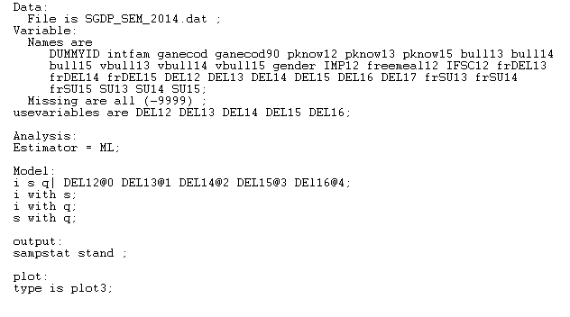
Example 1: Delinquency
Mplus code
Growth Curve Model:
Delinquency 12, 13, 14, 15 & 16 years.
Linear growth
Model:
i s | DEL12@0 DEL13@1 DEL14@2 DEL15@3; DEL16@4;
i with s; i with q; s with q;
Plot :
type = plot3 ;
Gives the most graphical options
I always use this command.
Specifies GCM
Allows intercept and slope and quadratic factors to correlate

Slide 18
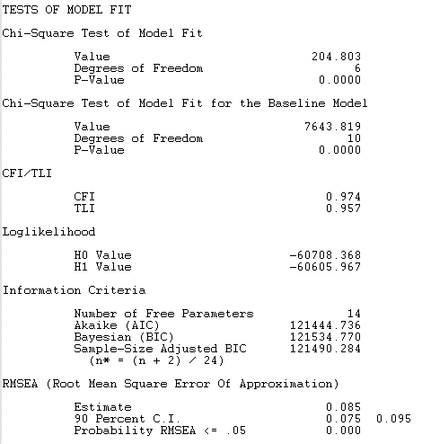
Example 1: Output
Do the means look reasonable?
Should we have included the quadratic term?
Does the model fit the data well?

Slide 19
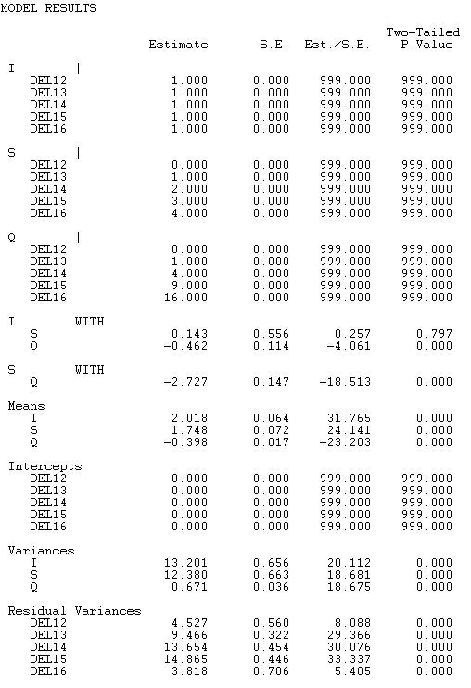
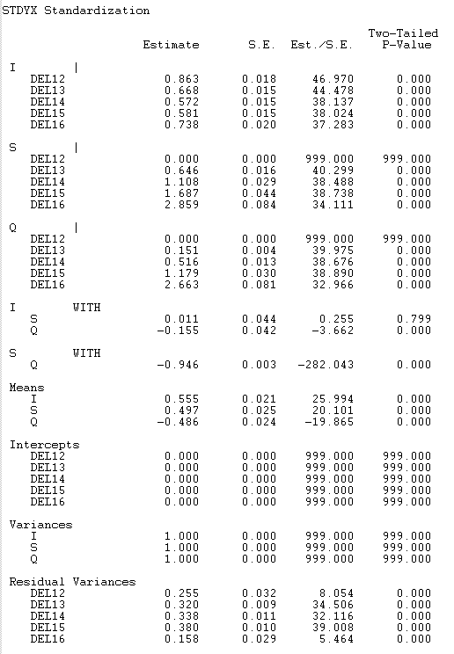
Example 1: Results

Slide 20
Practical 1
Mplus code
Growth Curve Model:
Delinquency 12, 13, 14, 15 & 16 years.
Linear growth
Model:
i s | DEL12@0 DEL13@1 DEL14@2 DEL15@3; DEL16@4;
i with s; i with q; s with q;
Plot :
type = plot3 ;
Gives the most graphical options
I always use this command.
Specifies GCM
Allows intercept and slope and quadratic factors to correlate

Slide 21
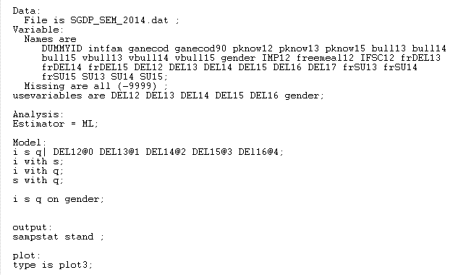
Example 2: Delinquency & covariate
Mplus code
Growth Curve Model:
Delinquency 12, 13, 14, 15, 16 years
Latent factors (i s q) predicted by gender
Model:
i s | DEL12@0 DEL13@1 DEL14@2 DEL15@3; DEL16@4;
i with s; i with q; s with q;
i s q on gender;
Gender predicting latent factors i s q.

Slide 22
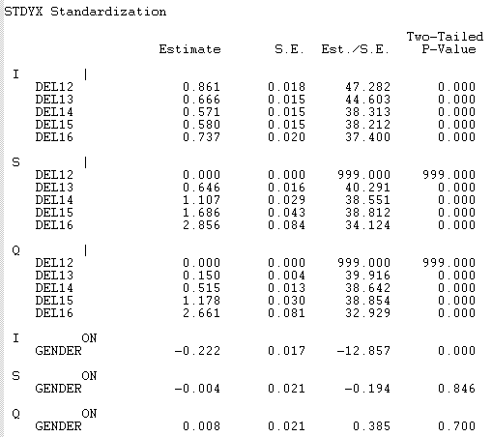
Example 2: Output
Does gender predict the intercept or slope of delinquency?

Slide 23
Practical 2
Mplus code
Growth Curve Model:
Delinquency 12, 13, 14, 15, 16 years
Latent factors (i s q) predicted by gender
Model:
i s | DEL12@0 DEL13@1 DEL14@2 DEL15@3; DEL16@4;
i with s; i with q; s with q;
i s q on gender;
Gender predicting latent factors i s q.

