Slide 1
Introduction
Rachael Bedford
Mplus: Longitudinal Analysis Workshop
26/09/2017
Download data here -
http://bit.ly/2fnnTzv
https://www.statmodel.com/demo.shtml

Slide 2
Schedule for the day
10.00-11.30:
Introduction: Longitudinal data analysis, SEM & Mplus
11.30-11.45:
Coffee Break
11.45-13.15:
SEM & Nested models
13.15-14.00:
Lunch
14.00-15.30:
Autoregressive & Growth Curve models
Download data here -
http://bit.ly/2fnnTzv
https://www.statmodel.com/demo.shtml

Slide 3
Example: Language Development
6 months
12 months
24 months
36 months

Slide 4
Stages of Research
1. Operationalize your hypotheses
2. Data collection/processing/collation
3. Check data distribution, descriptives, outliers
4. Graph effects
5. Inferential statistics (ideally pre-specified)
6. Post-hoc analyses & conclusions

Slide 5
1. Operationalising Hypotheses
What might we want to know about language development?
Does infant babbling predict later vocabulary?
How could we test this?
Measure language longitudinally in the same children from 6 - 36 months.
Possible issues:
Might need to use different measures at each age
Need to follow the same children (attrition)
Notes:
Does early language predict the subsequent rate of language development?
Are there subgroups of children who show different language profiles?
Are there individual differences in language trajectories?
Are the sex differences in language development?

Slide 6
2. Data Collection/Processing
How will the data be collected?
Standardised measures vs naturalistic
Hand coding questionnaires vs videos
Mullen standardised assessment
Expressive language
6 months e.g. Canonical babbling (bababa)
12 months e.g. Pat the baby
24 months e.g. Names pictures: ball, house…
36 months e.g. What is a hat?
Responses recorded by hand and entered into excel spreadsheet

Slide 7
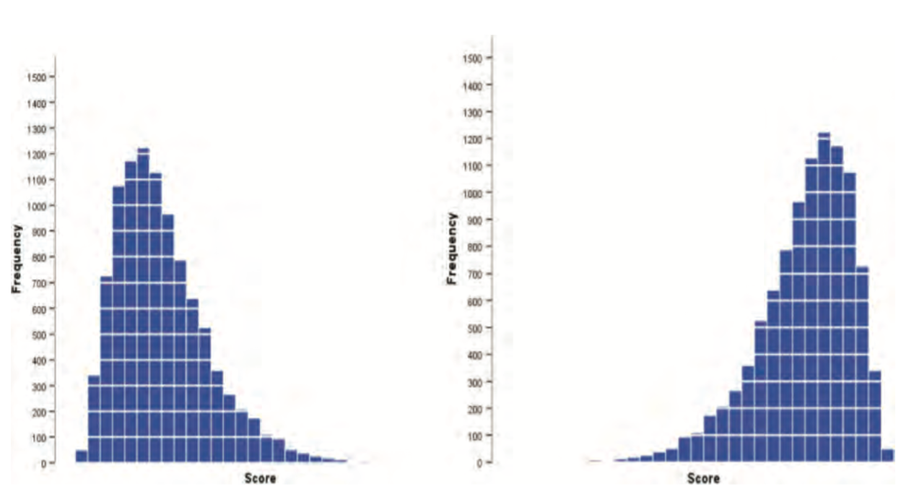
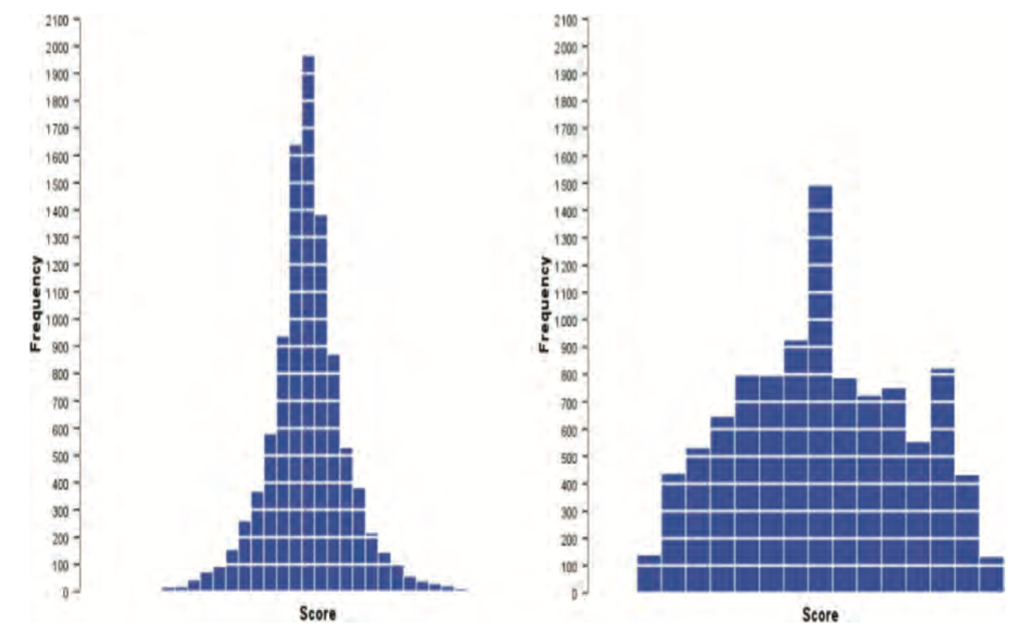
3. Descriptives and Outliers
Check the data:
means
standard deviations
skew
kurtosis
Identify outliers:
Boxplot/Scatterplot
+skew
-skew
+kurtosis
(leptokurtic)
-kurtosis
(platykurtic)
12 months
6 months

Slide 8
4. Graph effects
Between and within subject variation

Slide 9
5. Longitudinal Data Analysis
Data from repeated observations
A way to examine CHANGE over time
Allows ordering of correlations
Various problems with longitudinal data:
Expensive to collect
Problems with attrition – missing data
Serial dependence - correlated observations
Notes:
e.g. measuring the same variable over time violates the assumption of independent observations

Slide 10
Four types of longitudinal design
simultaneous cross-sectional studies
sample different age groups on the same occasion
trend studies
random sample of participants of the same age from the population, on different occasions
time series studies
participants are followed at successive time points
intervention studies
variation of time series: intervention/treatment affects only participants in the experimental group
Notes:
(like the cross-sectional religiousness example), making the assumption that there is no effect of cohort. No intra-individual change can be assessed as the individuals are different at each time point.
Time series: possible to assess both inter- and intra-individual change over time. Can be retrospective or prospective

Slide 11
Problem 1: Serial Dependence
Repeated responses for each individual will be correlated.
Independent t-tests and one-way ANOVA don’t take into account within subject correlation
lead to biased estimates
intra-individual change may be of specific interest
(Could use robust standard errors)

Slide 12
Problem 2: Missing Data
Missing completely at random (MCAR)
missingness does not depend on the values of either observed or latent variables
IF this holds can use listwise deletion
Missing at random (MAR)
missingness is related to observed, but not latent variables or missing values
Non-ignorable missing
Missingness of data can be related to both observed but also to missing values and latent variables
Notes:
if gender influences missingness of IQ score, but within males and females separately IQ score itself does not relate to the missingness of IQ data then for a model including gender the data are MAR
An example of non-ignorable missingness would be if those with higher depression are less likely to have missing data (because they were less likely to come in for the study).

Slide 13
Missing Data examples
Missing at random (MAR)
Sex influences missingness of IQ score (e.g. boys get up later and are more likely to miss the test)
But within males and females separately the IQ score itself does not relate to the missingness of IQ data (e.g. those with lower IQ are not more likely to miss the test that those with high IQ)
If model includes sex then data are MAR
Non-ignorable missing
Trial for depression where those with higher depression scores at post-test are more likely to have missing data (because they were less likely to come in for the study).
Missingness of depression score is related to the depression score itself.
Notes:
if gender influences missingness of IQ score, but within males and females separately IQ score itself does not relate to the missingness of IQ data then for a model including gender the data are MAR
An example of non-ignorable missingness would be if those with higher depression are less likely to have missing data (because they were less likely to come in for the study).

Slide 14
What can you do in SPSS?
Several standard methods do take account of serial correlation:
Paired samples t-test
Repeated measures ANOVA
Generalised Estimating Equations
Mixed models (with fixed and random effects)
Can impute missing data values
Other limitations to bear in mind:
Can’t covary different factors at different time points
Measurement error

Slide 15
Structural Equation Modelling (SEM)
Multivariate data analysis technique which can include both observed and latent (unobserved) variables
Three key steps in running SEM analysis:
Construct a model
Estimate model
Assess how well it fits the data

Slide 16
SEM notation
 | Observed variable
 | Latent factor
 | Effects of one variable on another (e.g., regression)
 | Covariance or correlation

Slide 17
Constructing a model
Basic building block in SEM: regression.
e
e
e
e
EL1
ß
EL2
EL3
EL4
Group

Slide 18
Mplus
Linda & Bengt Muthén

Slide 19
Key Model Commands
[ ] – mean
[X1]
- variance
X1
with – correlation or covariance
X1 with X2
by – factor is indicated by
F1 by X1 X2 X3
on – regression
Y1 on X1
; - end of a command
Y1 on X1;

Slide 20
Constructing a model
Basic building block in SEM: regression.
Mplus Code:
EL2 on EL1;
EL3 on EL2;
EL4 on EL3;
EL1-EL4 on group;
e
e
e
e
EL1
ß
EL2
EL3
EL4
Group

Slide 21
Model estimation
Mplus uses the variance-covariance matrix
Variance: movement of each flower varies
Covariance: how all flowers move together
(Latent variable (causing covariation): Wind)
Variance-covariance matrix
M1
M2
M3
M1
0.88
0.52 | 0.91
0.67 | 0.73 | 0.89
M2
M3

Slide 22
Model estimation
Various estimators:
Ordinary Least Squares (OLS) used in SPSS regression Maximum likelihood (ML)
Maximum likelihood with robust standard errors (MLR)
Weighted Least Squares (WLS)
Why is estimation important?
Influences quality and validity of estimates
In order to run a model it must be identified, i.e., all the parameters have only one solution
fewer or equal number of parameters to be estimated than components in the variance-covariance matrix

Slide 23
Maximum Likelihood
What does ML do?
ML identifies the population parameter values (e.g. population mean) that are most ‘likely’ or consistent with data (e.g. sample mean)
It uses the observed data to find parameters with the highest likelihood (best fit)
How does ML estimate parameters?
By constraining search for parameters within a normal distribution
Notes:
Also good for Missing data

Slide 24
Full Information Maximum Likelihood
Can apply ML to incomplete as well as complete data records
i.e. where data is missing in response variables
This is called Full Information Maximum Likelihood (FIML).
If data are missing at random we can use FIML to estimate model parameters.
Remember: Missing at random DOES NOT MEAN missing at random.
Notes:
Effect of attrition in LDA

Slide 25
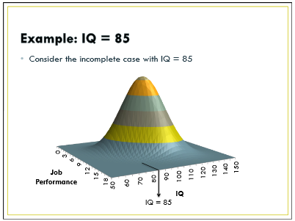
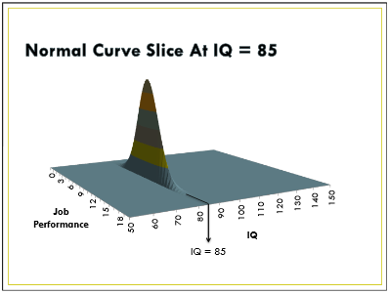
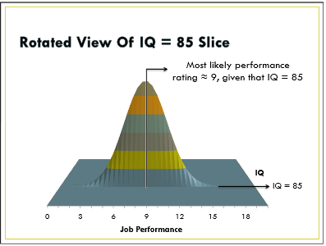
FIML missing Craig Enders
A case with an IQ 85 would likely have a performance rating of ~9.
Based on this information, ML adjusts the job performance mean downward to account for the plausible (but missing) performance rating
Notes:
animations

Slide 26
Multiple imputation
Another approach: Multiple Imputation
Multiple copies of the data set are generated, each with different estimates of the missing values.
Analyses performed on each of the imputed data sets, and the parameter estimates and standard errors are pooled into a single set of results.
Maximum Likelihood | Multiple imputation
Estimate parameters does NOT fill in missing values | Does fill in the missing data
Usually best for continuous data | Best for categorical or item level data
In a large sample ML and MI give the same results | In a large sample ML and MI give the same results

Slide 27
Model fit
Goodness of fit means assessing how well the model fits, i.e. how well it recreates the variance-covariance matrix
Can also compare fit of multiple models
Various fit indices:
χ² test of model fit
CFI
BIC
RMSEA
Notes:
Small sample size can affect the reliability of the parameter estimates.

Slide 28
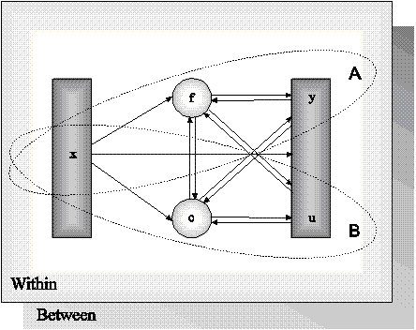
Mplus latent variable framework

Slide 29
Summary of SEM approach
Enables more complex questions to be addressed.
Allows some challenges associated with longitudinal data e.g., missing data, floor and ceiling effects, to be directly accounted for in the model.
Appealing tool to address questions about developmental processes.

Slide 30
Data
Edinburgh Study of Youth Transitions and Crime
ESYTC is a prospective longitudinal study of pathways into and out of offending amongst a cohort of more than 4000 young people in the city of Edinburgh
Focus of this course: Six annual sweeps of self-report surveys from cohort members (aged 12-17) and official records from schools

Slide 31
Mplus Command Language
Different commands divided into a series of sections
TITLE
DATA (required)
VARIABLE (required)
ANALYSIS
MODEL
Others that will be used
DEFINE (data management)
OUTPUT
SAVEDATA (e.g. factor scores, trajectory membership)
PLOT

