Slide 1
The PLR in ASD
11:45 - 13:15
Pär Nyström
Researcher, Uppsala Child- & Babylab
par.nystrom@psyk.uu.se

Slide 2
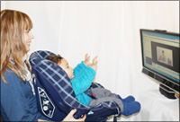
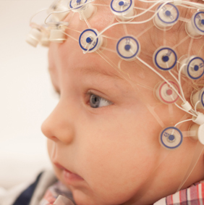
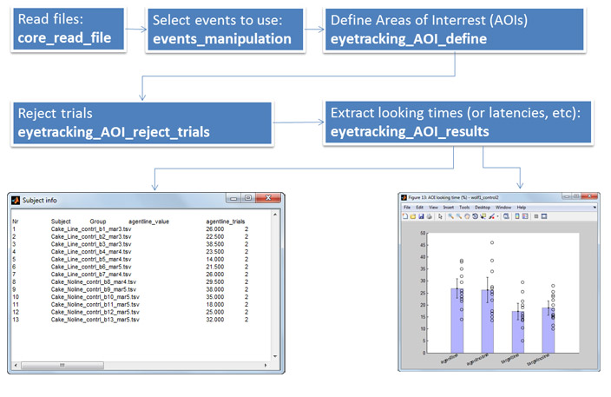
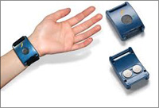
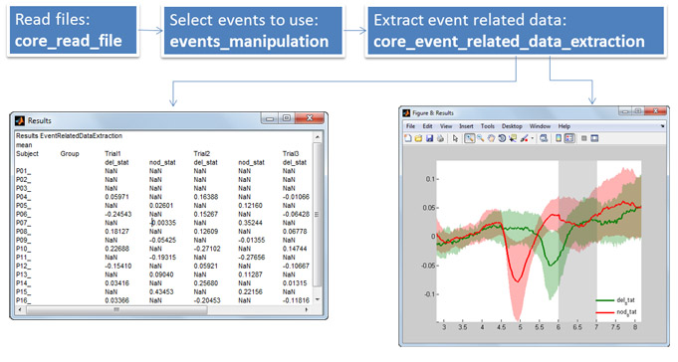
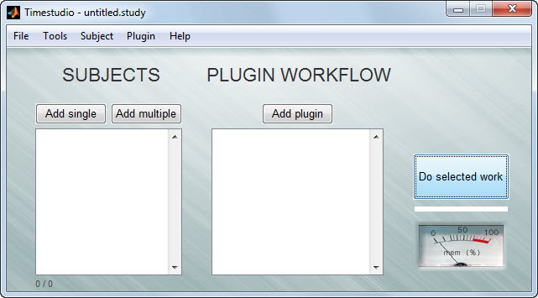
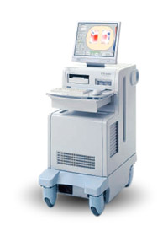
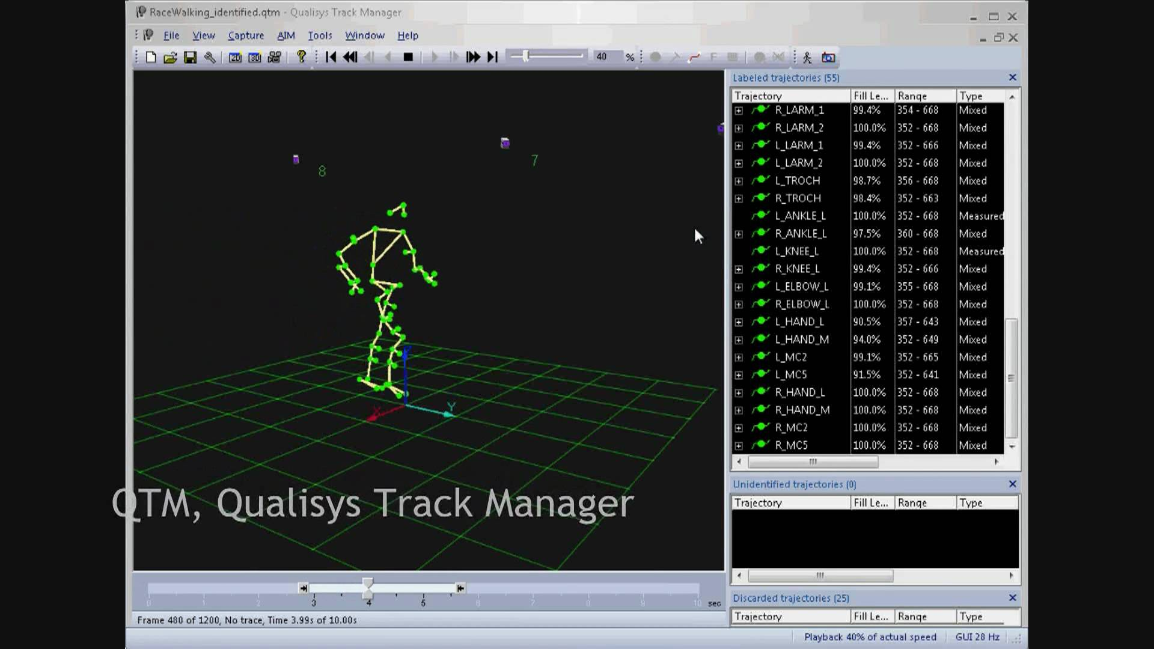

Slide 3
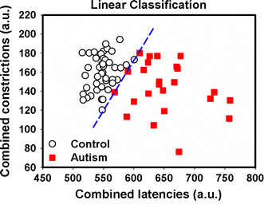
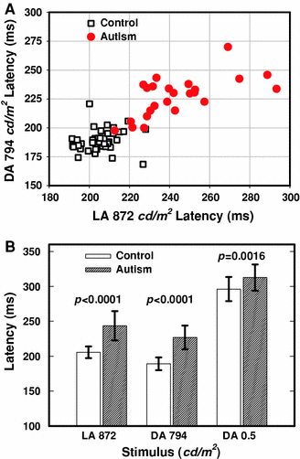
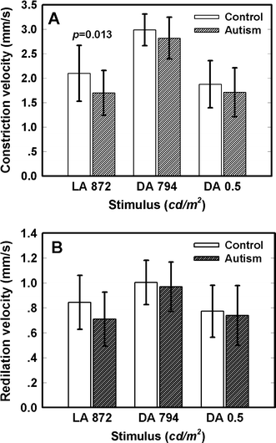
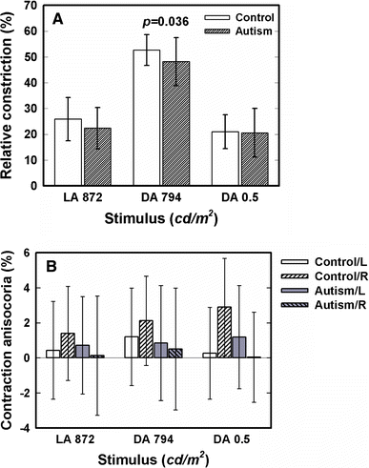
The PLR in ASD
Fan, X., Miles, J. H., Takahashi, N., & Yao, G. (2009). Abnormal transient pupillary light reflex in individuals with autism spectrum disorders. Journal of autism and developmental disorders, 39(11), 1499-1508.

Slide 4
The PLR in ASD
Fan, X., Miles, J. H., Takahashi, N., & Yao, G. (2009). Abnormal transient pupillary light reflex in individuals with autism spectrum disorders. Journal of autism and developmental disorders, 39(11), 1499-1508.
Fan, X., & Yao, G. (2011). Modeling transient pupillary light reflex induced by a short light flash. IEEE transactions on biomedical engineering, 58(1), 36-42.
Daluwatte, C., Miles, J. H., Christ, S. E., Beversdorf, D. Q., Takahashi, T. N., & Yao, G. (2013). Atypical pupillary light reflex and heart rate variability in children with autism spectrum disorder. Journal of autism and developmental disorders, 43(8), 1910-1925.
Daluwatte, C., Miles, J. H., Sun, J., & Yao, G. (2015). Association between pupillary light reflex and sensory behaviors in children with autism spectrum disorders. Research in developmental disabilities, 37, 209-215.
DiCriscio, A. S., & Troiani, V. (2017). Pupil adaptation corresponds to quantitative measures of autism traits in children. Scientific Reports, 7.

Slide 5
The EASE project
Early Autism SwEden (EASE)
Similar to other ASD sibling studies
Data collection currently at 5m, 10m, 14m, 18m, 24m, and 36m. Soon also at 6 years.
Experimental measures include fMRI, EEG, motion capture, live and screen based eye tracking, etc.

Slide 7
The PLR recap
four-neuron arc:
pretectal nuclei →
Edinger-Westphal nucleus →
ciliary ganglion →
iris sphincter

Slide 8
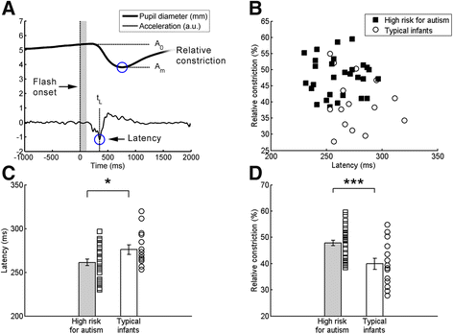
Our PLR studies
Nyström, P., Gredebäck, G., Bölte, S., & Falck-Ytter, T. (2015). Hypersensitive pupillary light reflex in infants at risk for autism. Molecular autism, 6(1), 10.

Slide 9
Theoretical discussion
The pupillary light response differs between different populations, such as between ASD and controls. What possible mechanisms/brain processes can you think of that could explain these differences?

Slide 10
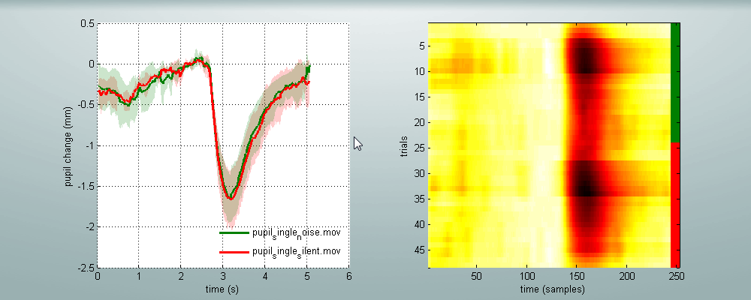
Condition 1: Single flash, no sound
Condition 2: Single flash, simultaneous white noise sound

Slide 11
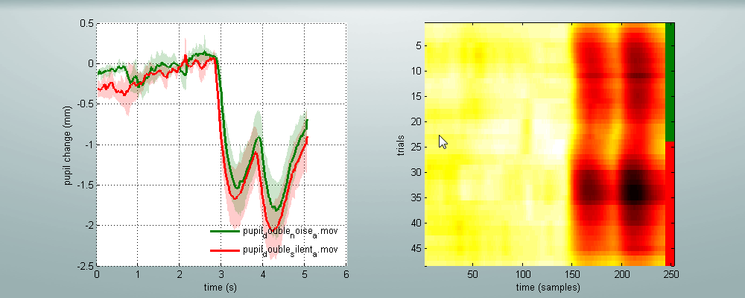
Condition 3: Double flash, no sound
Condition 4: Double flash, simultaneous white noise sound

Slide 12
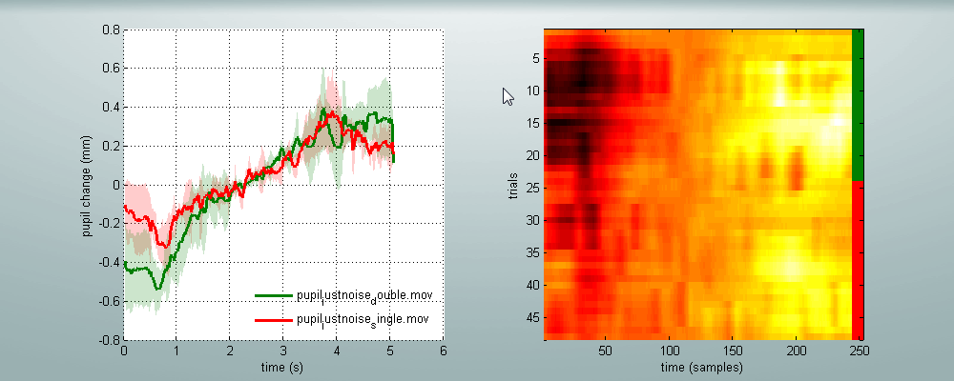
Condition 5: No flash, single sound burst
Condition 6: No flash, double sound burst
Condition 5: No flash, single sound burst
Condition 6: No flash, double sound burst
All subjects reported starle responses during sound presentations. However, this is not reflected in the pupil reflex.

Slide 13
Timestudio
Relates to “Good practice in research (replicability, pre-registaration, ethics)”

Slide 14
Timestudio
Demo uwid ts-f0a-260

Slide 15
ipRGCs ?!?
Hattar, S., Liao, H. W., Takao, M., Berson, D. M., & Yau, K. W. (2002). Melanopsin-containing retinal ganglion cells: architecture, projections, and intrinsic photosensitivity. Science, 295(5557), 1065-1070.
Berson, D. M., Dunn, F. A., & Takao, M. (2002). Phototransduction by retinal ganglion cells that set the circadian clock. Science, 295(5557), 1070-1073.

Slide 16
ipRGCs
Rods and cones are not alone!
Intrinsically photosensitive Retinal Ganglion Cells
interplay and project via dopaminergic amacrine cells
ipRGCs have a singular spectral sensitivity peak at approximately 480 nm (≈ cyan blue)
projections mainly targets the pretectal nucleus as part of the pupillary light reflex, and via the retinothalamic tract to the suprachiasmatic nucleus of the hypothalamus (which projects to e.g. the pineal gland to stimulate melatonin release) for circadian photo entrainment
Compared with rods and cones, ipRGCs react slower, do not habituate, and have a sustained response that usually decays gradually over several minutes.

Slide 17
ipRGCs
Hellmer, K., & Nyström, P. (2017). Infant acetylcholine, dopamine, and melatonin dysregulation: Neonatal biomarkers and causal factors for ASD and ADHD phenotypes. Medical Hypotheses, 100, 64-66.

Slide 18
Questions / discussion
par.nystrom@psyk.uu.se

